Slide 1
Technical Support (420-1N6-AB) Software Licensing
Fall 2021

Slide 2
What is a Software License?
An agreement between you and the owner of a software program that allows you to do certain things that would otherwise be an infringement of copyright law.
Usually answers questions such as:
Where and how often can you install the program?
Can you copy, modify or redistribute it?
Can you look at the underlying source code?
Note: The price of the software and any licensing fees are not usually associated with the software license

Slide 3
Key Points
Understand what "free" means in terms of software.
What is the End User License Agreement (EULA)
License term limits
Perpetual / term license.
Volume licenses / site licenses for multiple users / teams
Secondary or home use rights; for personal use outside of team

Slide 4
End User License Agreement (EULA)
Details of what you can and cannot do with software.
How many copies you can install?
What the software company can do with your data?
What additional software the company can install on your computer?
Written in legal language and often hard to comprehend.
Use https://tldrlegal.com/ to look up software licenses in simple English.

Slide 5
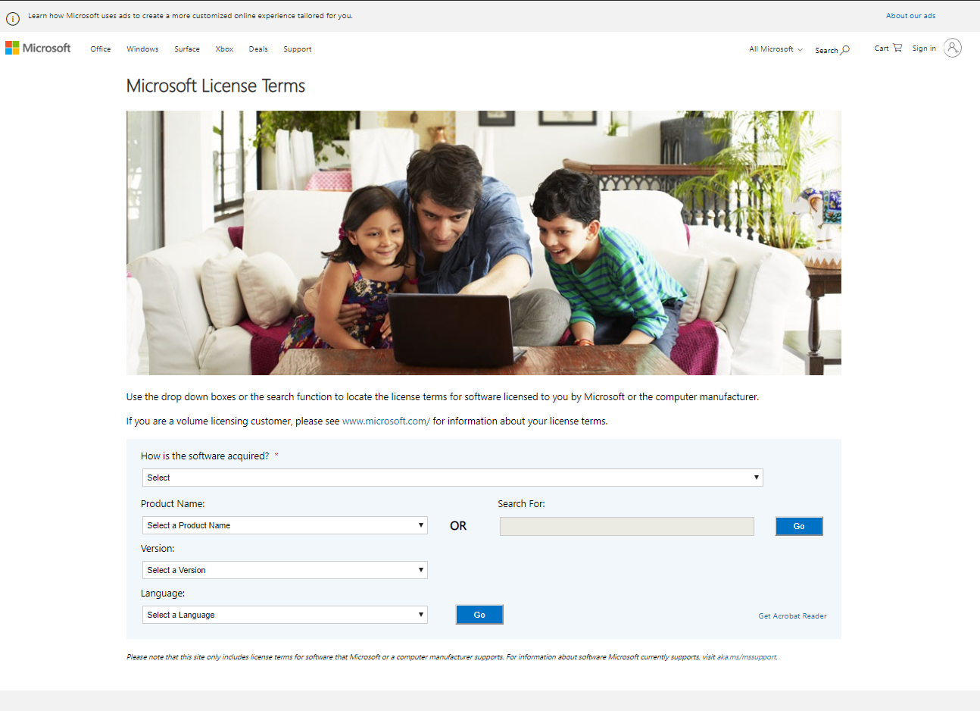
Samples of End User Agreements

Slide 6
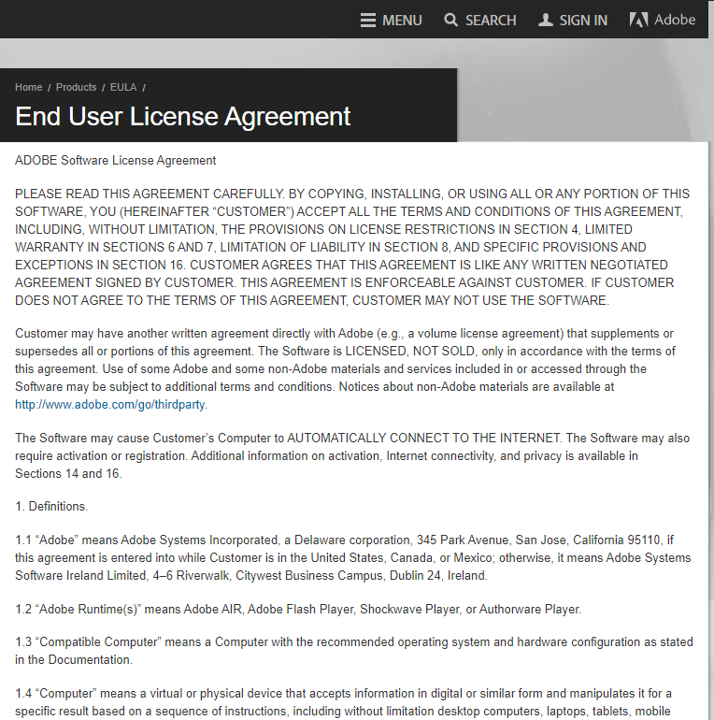
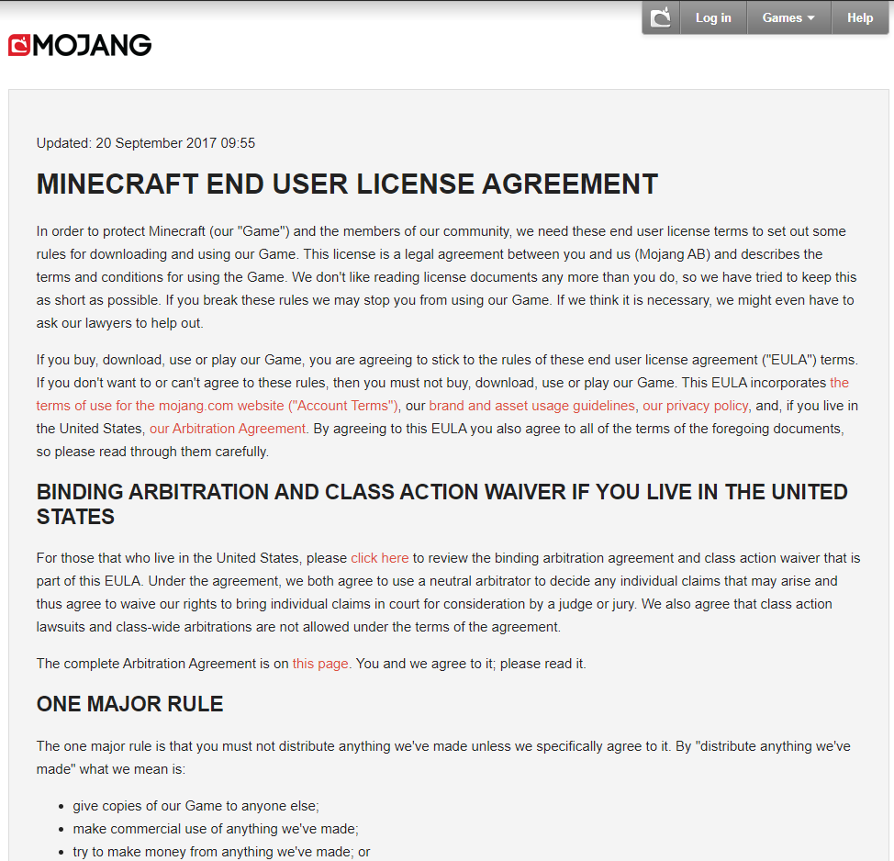
Samples of End User Agreements

Slide 7
Perpetual / Term (Subscription) License
Sometimes there is a time limit to your software license.
Perpetual licenses do not expire.
Term licenses expire after a specified period of time.
Often one year.
Must be renewed periodically.
Often called subscriptions.
Can you think of examples?

Slide 8
Licensing Trends
2011
$48 billion of total subscription revenue vs
$154 billion total license revenue.
2011-2016
Subscription revenue is growing at a faster growth rate than perpetual license revenue. (17.5% versus 4% respectively.)

Slide 9
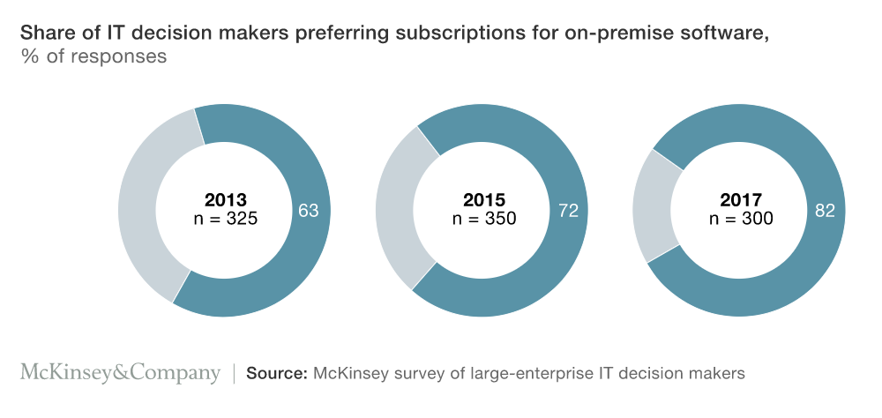
Licensing Trends on Management Levels
Source: https://www.mckinsey.com/industries/technology-media-and-telecommunications/our-insights/subscription-myth-busters

Slide 10
Advantages and Disadvantages of perpetual / subscription licensing?

Slide 11
Advantages / Disadvantages
Perpetual License | Subscription
Has no expiry date. | Recurring payment (often 12 months).
Usually doesn’t include support or updates. | Often includes support, updates and upgrades.
May be offset against a tax benefit. | Smaller payments are easier to handle.
Note: Costs vary for each license type. The break-even point is often 3-4 years, where subscription starts to cost more than the purchase of a perpetual license would have cost. Keep in mind that perpetual license might not include version updates of the software while subscription licenses usually does.

Slide 12
Volume / Site Licenses
Some software developers offer volume / site licenses.
These often depend on:
Size and type of the organization.
Products you want to use (and therefore license).
The way in which you want to use these products.

Slide 13
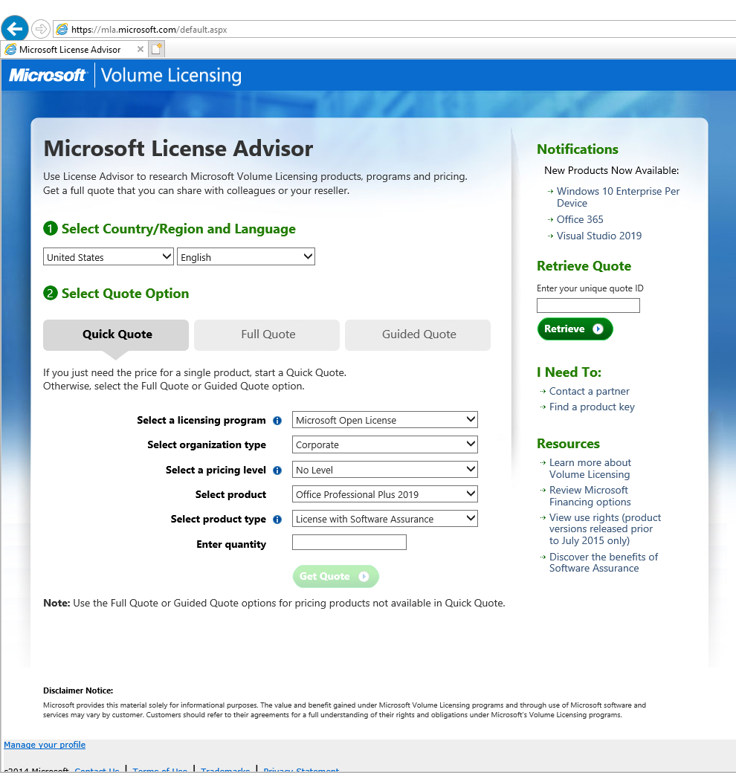
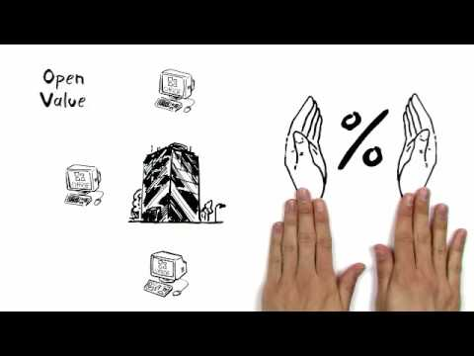
Microsoft Volume Licensing Guide

Slide 14
Secondary Use
Secondary use rights allow the user to use software on two devices.
The secondary device may be:
A home PC ('Home-Use Rights’) or
A laptop ('Portable-Use Rights’).
Some Microsoft applications allow secondary use rights, e.g. Microsoft Office.
Secondary use rights are also available for some developer tools.
For each license acquired, a single person may install copies on any number of computers, as long they are the only person who uses these copies.

Slide 15


License Documentation
KEEP DOCUMENTATION
ALWAYS KEEP A RECORD OF SOFTWARE PURCHASES, ACTIVATION KEYS, DATE OF LICENSE, ETC.

Slide 16
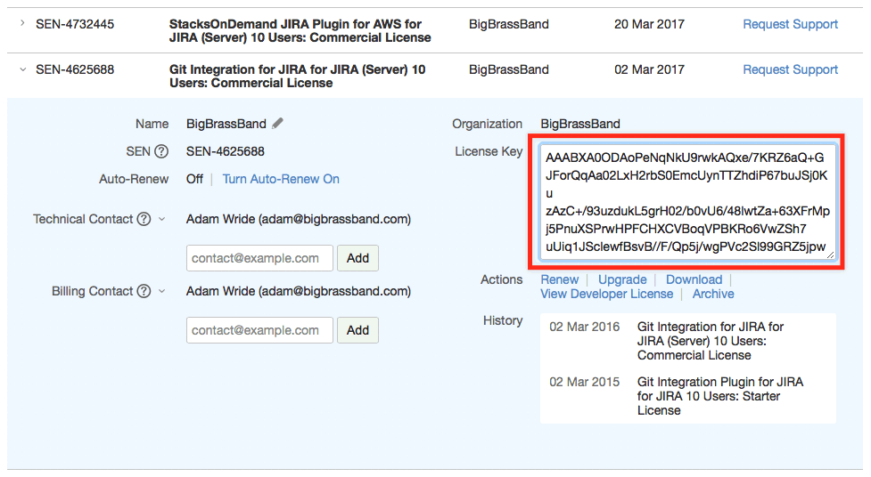
License Documentation: Tools
https://bigbrassband.com/git-integration-for-jira/documentation/managing-license-key.html

Slide 17
Installation and Activation
The process of software installation and activation depends on the product. Here are some key terminologies helpful to undergo the process.
License Key
Usually a long string of letters or numbers entered during the installation process.
Ensures that user complies with copyright restrictions and is authorized to use the software.
Activation
The process of entering your license key to enable the full set of features available.
Deactivation / Transfer
When you want to stop using software on one computer and start using it on another, you may need to deactivate the license on old computer before you transfer software to new computer.

Slide 18

Free Software
Software that respects users' freedom and community.
Freedom to run, copy, distribute, study, change and improve the software.
A program is “free software” if its users have the four essential freedoms:
The freedom to run the program as you wish, for any purpose.
The freedom to study how the program works and change it.
The freedom to redistribute copies so you can help your neighbor.
The freedom to distribute copies of your modified versions to others.

Slide 19

Open-Source Software
In 1998, part of the free software community splintered off and began campaigning in the name of “open-source”.
Originally proposed to avoid misunderstanding of the word “free” but later become associated with philosophical views different to those of the free software movement. The emphasis was changed from freedom to security, cost savings, transparency and other pragmatic (practical) benefits.
The OSI's Open Source Definition is based directly on the Debian Free Software Guidelines. Software that is considered “free” is almost exactly the same as the actual category of software that is considered “open source”.

Slide 20
Open Source Definition
Open source does not only mean access to the source code. Distribution terms of open-source software must comply with the following criteria:
Free Redistribution.
Source Code.
Derived Works.
Integrity of The Author's Source Code.
No Discrimination Against Persons, Groups, or Fields of Endeavour.
Distribution of License.
License Must Not Be Specific to a Product, Restrict Other Software, Technology-Neutral.

Slide 21


Confused?
What is the difference between free and open-source software?

Slide 22
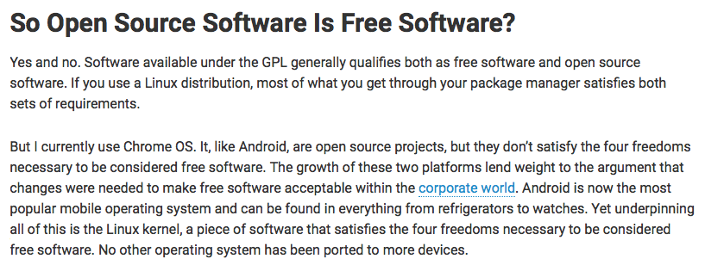

Slide 23
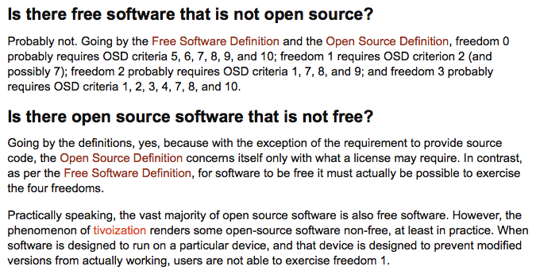

Slide 24
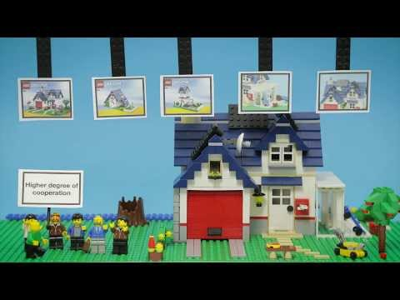
(5 mins)

Slide 25

GNU General Public License (GPL)
Widely-used software license given to “free software”.
Guarantees users the freedom to run, share, copy and modify the software.
The GPL grants users of a program the rights of the Free Software definition and uses copyleft to ensure that these freedoms are preserved whenever the program is modified, added to and distributed. Software under this license is free and open-source.

Slide 26
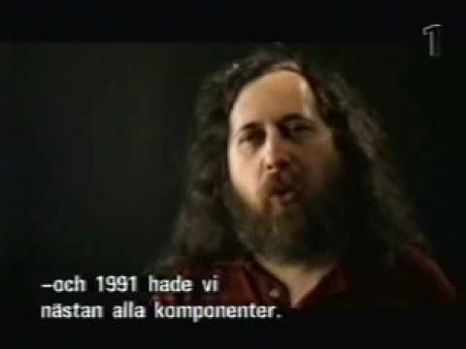
(4 mins)

Slide 27
Copyright
Berne Convention for the Protection of Literary and Artistic Works
International agreement governing copyright.
First accepted in Berne, Switzerland in 1886.
Anything written down is automatically copyrighted.
Copyright exists the moment a work is “fixed” rather than requiring registration.
Also enforces requirement that countries recognize copyrights held by citizens of all other signatory countries.

Slide 28
Copyleft
General method for making a program free.
Requires that all modified and extended versions of the program are also free.
Background
The simplest way to make a program free is to put it in the public domain uncopyrighted. But this means that uncooperative people can get it and turn it into proprietary software.
Solution
By using copyleft, a program is first stated as copyright. Distribution terms are added so everyone has the right to use, modify and redistribute the program’s code (or anything derived from it) as long as distribution terms remain unchanged.

Slide 29
Proprietary Software (Licensed)
Non-free software for which the software's publisher / developer retain intellectual property rights
Usually copyright of the source code.
Vendors typically distribute proprietary software in compiled form.
Source code is kept hidden.

Slide 30
Proprietary Software (Licensed) (2)
Proprietary software may also be limited to a specific set of hardware.
Example: Mac OS X is limited to Apple hardware by licensing and also various design decisions.
Some vendors distribute the source code or otherwise make it available to customers.
True for many web applications. (source code must be available when being run by a web server for customization purposes).
The source code is covered by a non-disclosure agreement or a license that allows, for example, study and modification, but not redistribution.

Slide 31
Freeware
Software is free to use.
Usual free for use for personal use.
Business uses may have to pay a fee.
Allows check the terms and condition of use before installing on a business PC.
Developers do not have to publish source code.
You can’t sell freeware software.

Slide 32
Shareware
Software is free on trial basis.
Try it then buy it.
Users can have access to the software for a limited time before it expires.
Not all software features are available or have limited use.

Slide 33

Public Domain Software
Software that is not copyrighted.
There is no ownership. Software in the public domain can be modified, distributed or sold without being attributed to anyone.
Note: A program can be in the public domain, but the source code may not be available. This is not free software, because free software requires accessibility of source code.
Most free software is not in the public domain; it is copyrighted, and the copyright holders have legally given permission for everyone to use it in freedom, using a free software license.

Slide 34
Q & A
Notes:
In Slide Show mode, click the arrow to enter the PowerPoint Getting Started Center.

